Slide 1
BIRLA INSTITUTE OF TECHNOLOGY & SCIENCE, PILANI
School Admission management system
      By-
      Sonal Singh 201619TW073 / 11007545
      Harshali Jadhav 201619TW032 / 11007423
      Upasana Deshmukh 201619TW559 / 11007143
      Tanvi Dhiman 201619TW118 / 11007557
      Kshitija Jadhav 201619TW095 / 11007431

Slide 2
Problem definition :
Today all the work at the time of admission of the student is done manually by ink and paper, which is very slow and consuming much efforts and time.
It is required to design of a computerized automated student admission system , to speed up and make it easy to use a system.

Slide 3
Purpose:
This document gives the detailed functional and non-functional requirements mentioned in.
It should be utilized by software developer to implement the system.

Slide 4
SRS of School Management system
School management system database contains data of multiple school.
Each School has a unique ID(SC-id), name(SC-name) and contact number (SC-contact)
Every school has only one management team.
The management team manage different department where each department has its own unique department id(D-id) and department name (D-name).
Each department has staff which has their staff member’s id (ST-id) and staff member name (ST-name).

Slide 5
Every staff has their office where student can collect form, receipt and selection details.
Every department has admission committee which manage he admission of student.
Student has student id(S-id) , student name (S-name), DOB(S-dob), Standard(S-standard) and contact number (S-contact).
Each student can gather information from office according to their department ad staff.

Slide 6
ER- DIAGRAM
S-name
School
Conduct
Admission
S-contact
S-id
Has
Applies
S-id
Name
Management
Manage
DOB
Student
Standard
Details
Has
Admission
Committee
Selects
Department
Gather information
D-name
D-Id
O-Id
Receipt
Staff
ST-id
Form
Selection
ST-name
Has
Office

Slide 7
Student
Admission
Management
Apply for admission
Collect Data
Check for eligibility
Give admission
Figure:- Sequential diagram of school management system

Slide 8
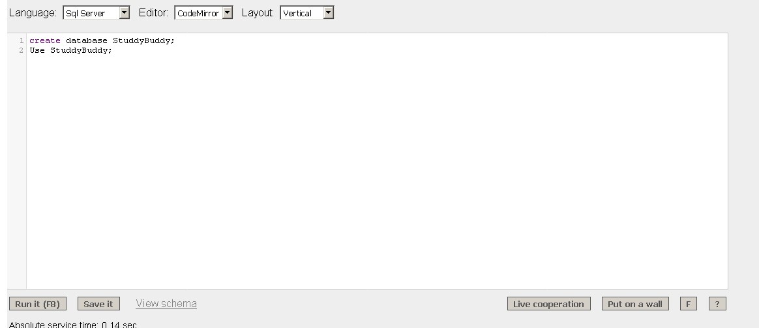
Query for Creating and using the database:
Create database StuddyBuddy;
Use StuddyBuddy

Slide 9
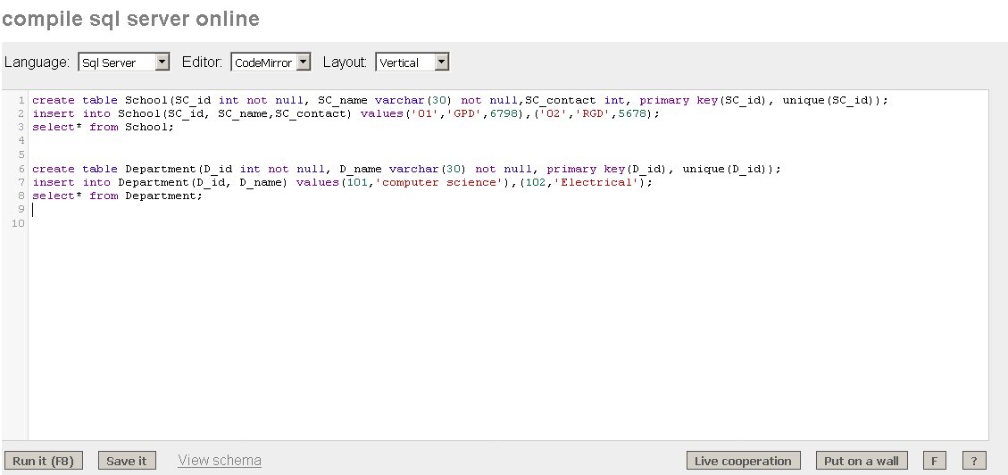
2) Query for Creation of school table :
  create table student(ST_id int not null, ST_name varchar(30) not null, ST_contact int, primary key(ST_id), unique(ST_id));

Slide 10
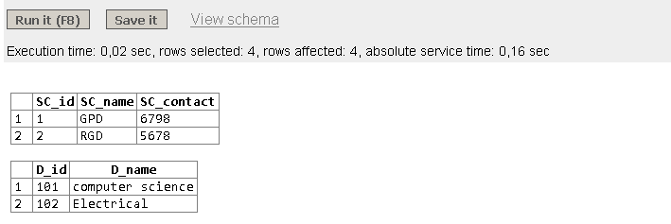
3) Query for Insertion into School table:
Insert into Student (ST_id,ST_name,ST_contact) values(01, 'Harshali', 995544),(02,'Kshitija',956622);

Slide 11
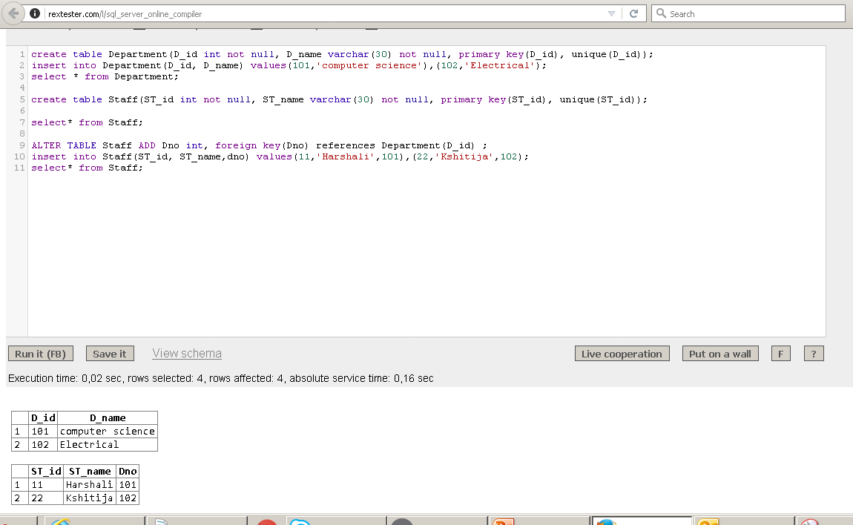
4) Query to show the data of the table :
  select* from Student;

Slide 12
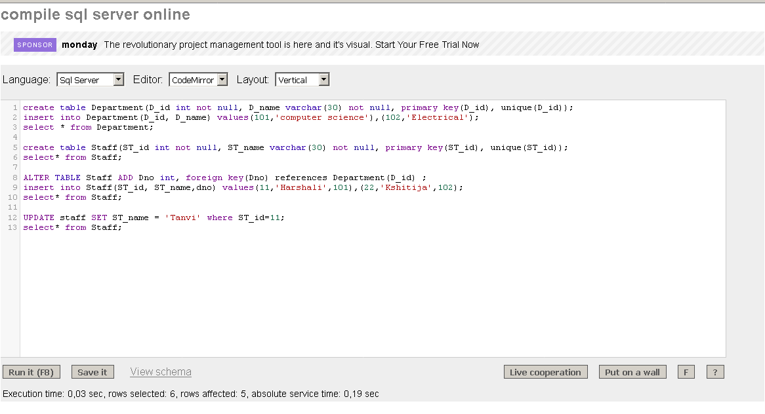
5) Query to alter the table schema:
alter table Staff add Dno int, foreign key(Dno)references Department(D_id);

Slide 13
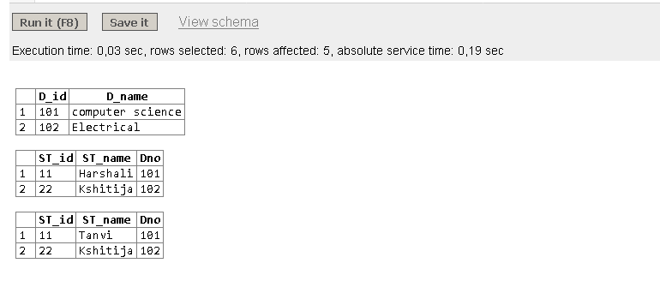
6) Query to update the value of any particular field:
update Staff set ST_name='Tanvi' where St_name='Harshali';

Slide 14
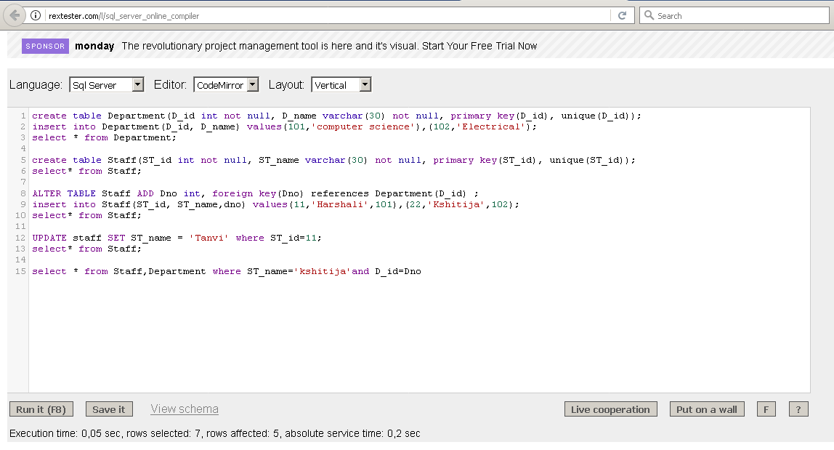
7) Query to show any particular row or field using two different table(Relation of the table) :
select* from Department,Staff where ST_name='Kshitija' and Department.D_id=Staff.Dno;

Slide 15
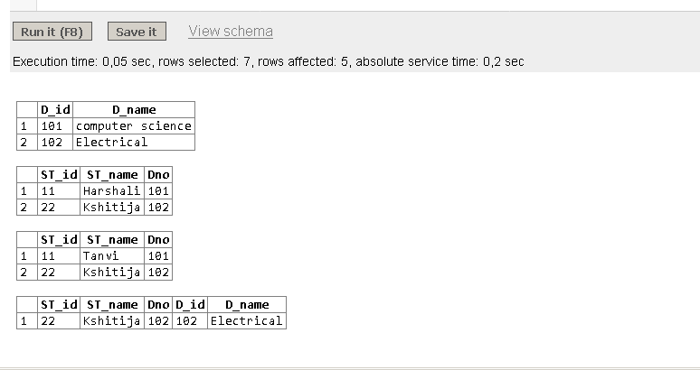

Slide 16


